Slide 1

Men vs. Women
Who rules the sky (and beyond) when it comes to NASA hiring rates?
Kaity Tainer, Cynthia Cardenas, Elesha Hunter, Kendra Sawyer, Rachael Reich, Stacey Gonzalez

Slide 2


Rachael Reich
BA Mechanical Engineering

Slide 3

Cynthia Cardenas
BA Elementary Education

Slide 4

Elesha Hunter

Slide 5

Kendra Sawyer
BS Music Education

Slide 6

Stacey Gonzalez
BA Political Science
BS Sociology
MS Psychology MPH Public Health and Epidemiology
Phd International Psychology
Massive Incident Reaction Team certification from Homeland Security
Retired Commander of the United States Army Air Defense Artillery Certified Officer of the Philadelphia Police Department and Critical Incident and Trauma certification.
NCIC / PCIC certification, SQL certification, Bias and Diversity certification from the Anti-Defamation League

Slide 7

Kaity Tainer
BA Psychology (University of Washington, 2016)
USPA Member (2016)
Currently Employed: Electrician
Past employment:
Executive Assistant

Slide 8
Background
Due to direction from President Eisenhower NASA suggested astronauts be chosen from military
test pilots
We can see from 1959-1980 65% came from the military
Overall less women come from the military
The 1970s was a stepping stone that lead women a step closer to becoming astronauts. At the
same time, the military began accepting women for pilot training that eventually led to women
astronauts.[2] In 1977, the recruitment of NASA skyrocketed because of Nichelle Nichols's help.[3]
Part of the advantage Nichols had in the recruitment was that her role as Lieutenant Uhura on Star
Trek inspired young girls to become astronauts at NASA when they grow up.[3]

Slide 9
Background
The 70’s: a springboard for women in astronomy
Women had worked behind the scenes since 1922
Cinema popularized women in the field
A popular one: Star Trek

Slide 10
Goals
Use Python for data analysis
Wrangle data
Data analysis
Data visualization
Gather findings

Slide 11
Assumptions/Predictions

Slide 12
Exploratory Analysis

Slide 13
Variables

Slide 14
Correlations

Slide 15
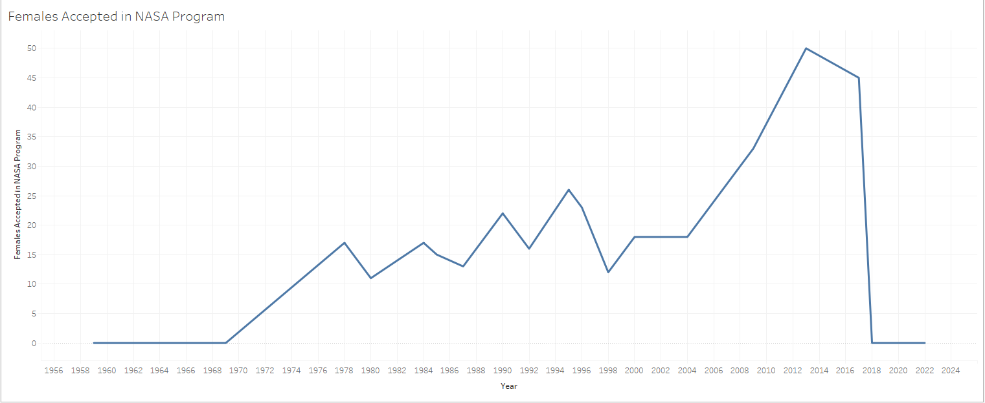
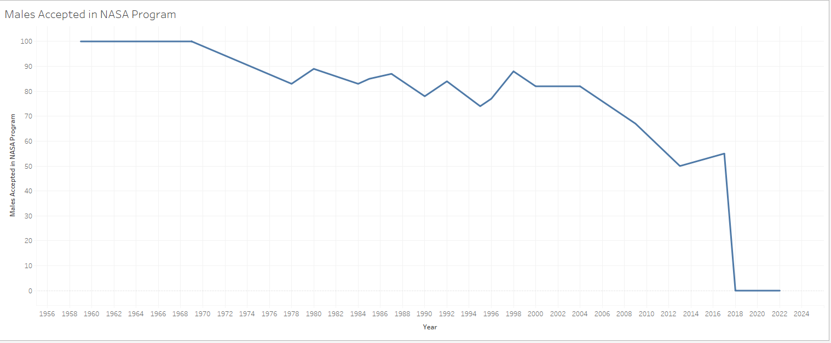

Slide 16
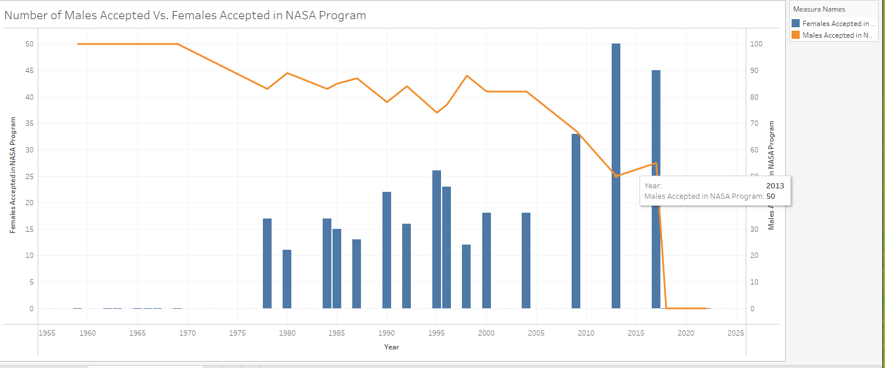

Slide 17
Summary/Regroup

Slide 18
(Next analysis questions based on what we found)

Slide 19
Conclusion

Slide 20
Questions?

